Slide 1
Friends Against Scams

Slide 2
About the National Trading Standards Scams Team

Slide 3
About Friends Against Scams
‘Take a Stand Against Scams.’

Slide 4
Who is who in Friends Against Scams?
Friends
SCAMchampions
SCAMbassadors
Organisations

Slide 5
Why is learning about scams important?
Why is learning about scams important?

Slide 6
Scams What's the problem?

Slide 7
Oxford Dictionary Definition A ‘Scam’ is a trick, a ruse, a swindle, a racket’ Its nearest synonym is ‘FRAUD’

Slide 8
No matter what type of scam, it is important to remember that ALL scams are CRIMES

Slide 9
To get victims hooked and responding to scams, criminals rely on…

Slide 10
Loneliness
Vulnerability
Social Isolation
Shame
and…

Slide 11
The fact that people don’t REPORT that they have been scammed ONLY 5% of these CRIMES are reported

Slide 12
The average age of a scam victim is 75, showing that criminals tend to prey on older and often more vulnerable members of society.

Slide 13
Anyone can be a scam victim
Criminals are experts at what they do and no one should be ashamed of falling victim.

Slide 14
Once a victim has responded to a scam…

Slide 15
…their personal details are repeatedly shared and sold on…

Slide 16
…and criminals will use this information to relentlessly target them.

Slide 17
Scam victims SUFFER IN SILENCE

Slide 18
Victims are often lonely and the criminal is the only ‘friend’ they have.

Slide 19
Leading to situations like these…

Slide 20
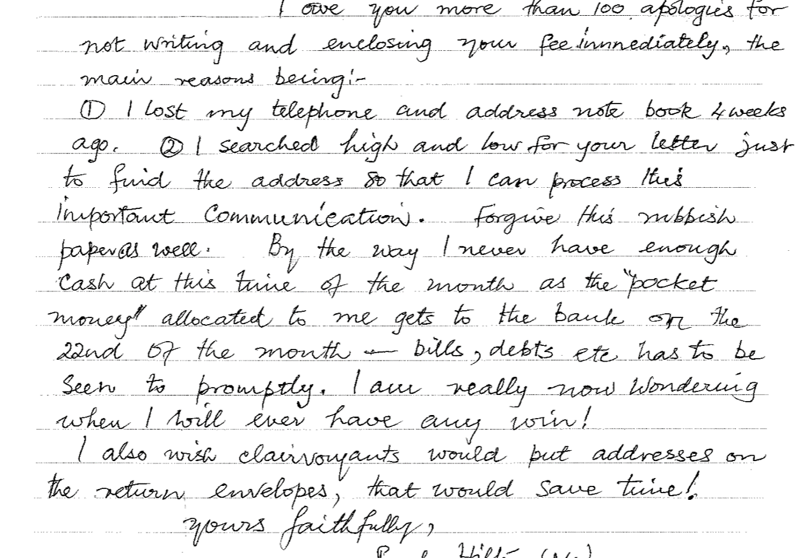
Letter from a victim to a criminal
“By the way I never have enough cash at this time in the month, I am really now wondering when I will ever have any win.”

Slide 21
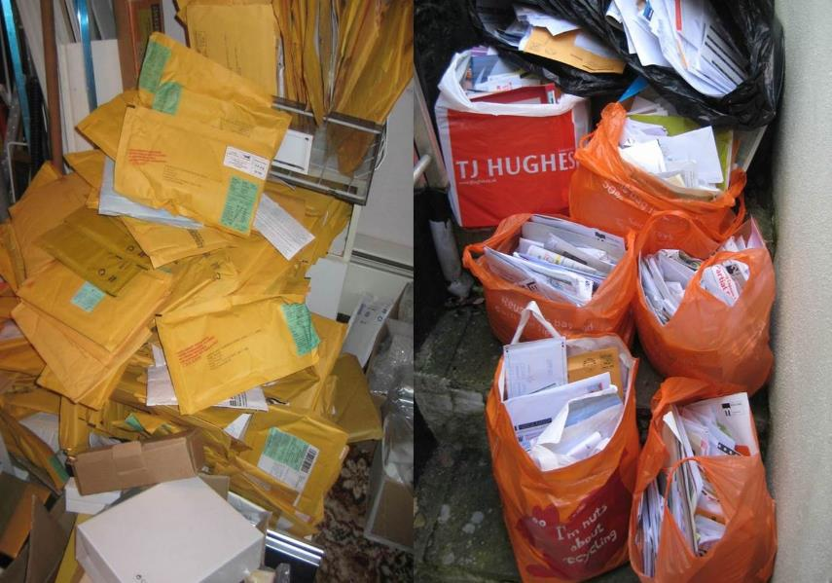
Scam victim’s house.

Slide 22
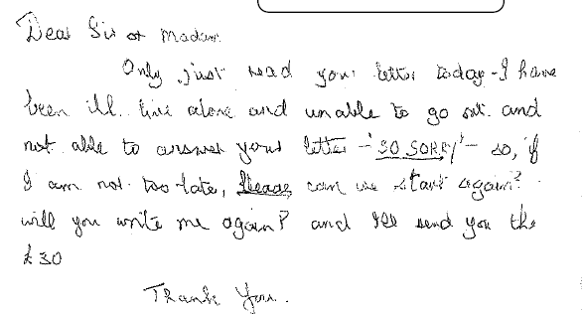
Letter from a victim to a criminal
“So sorry, so if I’m not too late,
PLEASE can we start again?
Will you write to me again and
I’ll send you your £30?”

Slide 23
Leaving the victims to feel like this…

Slide 24
“I hope I win, so I can move to a home. I want someone to talk to.”
“I get up, I wait for the post, I sort it, I go to bed.
What else have I got? I might as well be dead.”
“I don’t get out, because I'm frightened. These letters are all the company I ever get.”

Slide 25
One victim was found to have been receiving 30 pieces of mail and 10 phone calls per day.
It was later discovered she had lost over
£1 million.

Slide 26
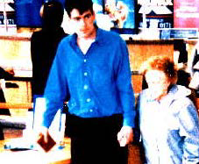
Doorstep scams victim being escorted to the bank

Slide 27
The stress and pain of victimisation often results in depression, isolation from family and the deterioration of mental health.

Slide 28
In some cases, victims have attempted to, or taken their own life.

Slide 29
These victims are not going to win or receive the millions of pounds that are ‘waiting’ for them…
(for a small fee)

Slide 30
As you can see, the problem is immense

Slide 31
Scams cost the UK economy between £5-10 billion a year

Slide 32
By talking about scams and highlighting the scale of the problem…

Slide 33
…we can take away the shame and prevent people from becoming a scam victim.

Slide 34
Together we can
TAKE A STAND AGAINST SCAMS!

Slide 35
Types of scams
Postal scams
Telephone scams
Doorstep scams
Online scams

Slide 36
Postal Scams
A victim in Yorkshire added together all the alleged winnings from postal scam mail and over a six month period she would have won £2.8 million.
Lottery or Prize Draw Scam
Catalogue Scam
Clairvoyant Scam
Inheritance Scam

Slide 37
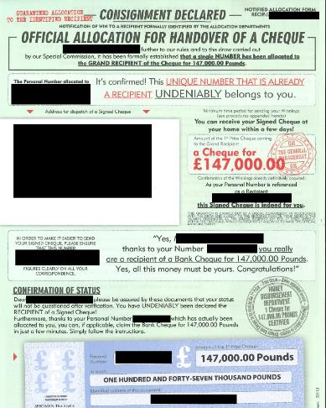
Would you respond?
Customer’s 1st name is used in the letter to make it personal.
PO Boxes are used instead of full postal addresses.
Often says to keep their winnings a secret.
Fake testimonials or money back guarantees to make offer seem genuine.
Requests money first before getting prize.
Letter is written to put people under pressure to reply.
Made to look authentic with directors name, picture and signature.

Slide 38
Telephone Scams
In a recent project, whereby
call blocker devices were installed
in the homes of those experiencing scam and nuisance calls, 95% of the applicants who previously felt threatened or scared by scam or nuisance calls no
longer felt this way.
Impersonation scam
Service interruption scam
Pension scam
Tech support scam

Slide 39
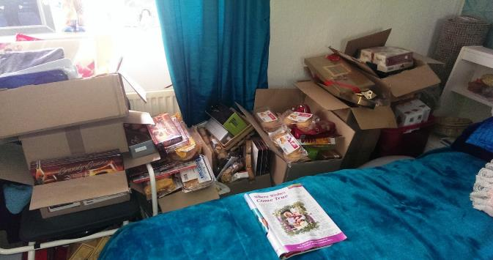
Mr G’s story

Slide 40
Doorstep Scams
Lottery or Prize Draws
Catalogue Scam
Clairvoyant Scam
Inheritance Scam
You are legally entitled to a 14-day cooling off period for contracts made in your home.
Doorstep Callers (Rogue Traders)
Bogus Callers (Distraction Burglary)

Slide 41
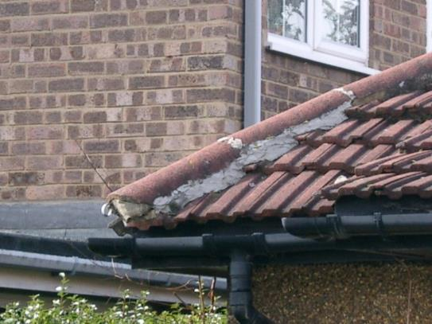
The twin’s story

Slide 42
Online Scams
53 per cent of the population now view online crimes as seriously as 'physical world' crimes, destroying the notion internet fraud is 'faceless' and of less importance than
other offences.
Romance scam
Phishing
Pharming
Social media scams

Slide 43
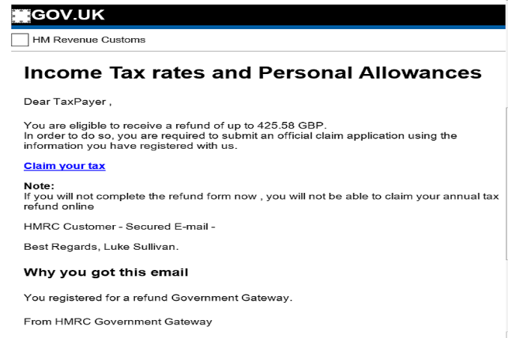
Would you respond?
Not addressed to you
No reference number
Hyperlink leading to a phishing website
No explanation of the refund
Not official email address
Sense of urgency

Slide 44
How to spot a victim…
Postal Scams
Post office
Mail
Stamps
Cheque books
Products
Free gifts
Telephone Scams
Phone calls
Payments
SMS messages
Friends
Helpful caller
Opportunities
Doorstep Scams
Poor quality
Unnecessary work
Fearful
Pressure
Cash withdrawals
Online Scams
Suspicious emails
Final demands
Refunds
Online relationship
Payments
Financial hardship and / or self neglect

Slide 45
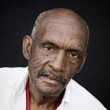
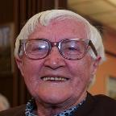
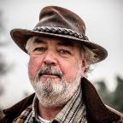
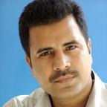
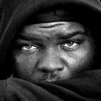
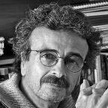
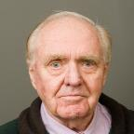
Anyone can be a scam victim.
Health issue
Dementia
Vulnerable
Socially isolated
Lonely
Pressure
Sense of purpose
Targeted by criminals
Trust easily

Slide 46
Consequences of falling for scams…
Increased debts
Poor mental, physical or emotional health
Attempt to, or take own life
Damaged relationships
Repeat victimisation
More likely to end up in care

Slide 47
Techniques used by the criminals
Criminals are experts at using befriending and grooming techniques to lure their victims.
They start like this
and quickly move to this
Appearing legitimate
Helpful
Persuasive
Persistent
Friendly
Charming
Threatening
Aggressive
Intimidating

Slide 48
Test your knowledge!

Slide 49
Take Five – Protect yourself
Criminals are experts at impersonating people, organisations and the police. They spend hours researching you for their scams, hoping you’ll let your guard down for just a moment. Stop and think. It could protect you and your money. www.takefive-stopfraud.org.uk
STOP
Taking a moment to stop and think before parting with your money or information could keep you safe.
CHALLENGE
Could it be fake? It’s ok to reject, refuse or ignore any requests. Only criminals will try to rush or panic you.
PROTECT
Contact your bank immediately if you think you’ve fallen for a scam and report it to Action Fraud.

Slide 50
Helping friends and family
Contact their bank straight away – they may be able to stop a payment or recover some money.
Talk – if you suspect that someone is a victim, you should try to talk to them. Take time to listen and don’t judge them.
Report – if you become aware or suspect a scam, you can report your concern to Action Fraud.
Seek further help – you can get further help and advice from the Citizens Advice Consumer Helpline.

Slide 51
Call blocking
Protect from scam and nuisance calls
Allow trusted callers to get through
Research shows that simply being in receipt of these calls can have a negative effect on wellbeing
There are a variety of products available to suit individual needs

Slide 52
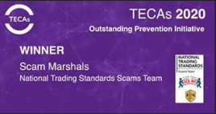
Scam Marshal
Scam Marshals send in their scam mail to the investigations team (Freepost)
They can talk to family and friends about the good work they do to help raise awareness
The investigators use their mail to help disrupt and prosecute the criminals
They help to take a stand against scams – sign up today if you think you can help

Slide 53
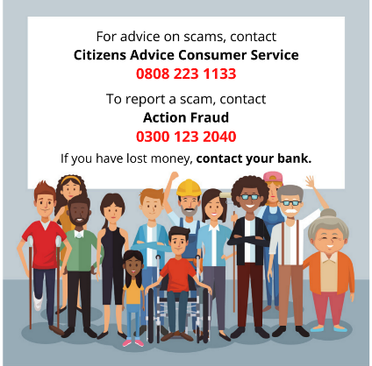
Reporting and advice
England and Wales
Click on the country to view the reporting and advice numbers in your area

Slide 54
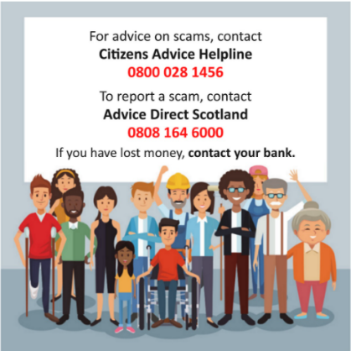
Reporting and advice
Scotland

Slide 55
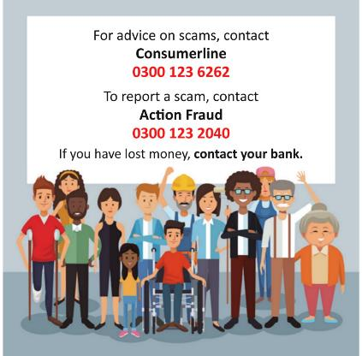
Reporting and advice
Northern Ireland

Slide 56
Congratulations! You are now a Friend Against Scams.
Music: www.bensound.com

Slide 57
What’s next?

Slide 58
Make a pledge and turn your knowledge into action.

Slide 59
Some example pledges to get you thinking about what you can do:

Slide 60
Tell 2 people about Friends Against Scams.
Share your Friends Against Scams status on social media

Slide 61
Encourage someone you know to take this training.
Support people in your community who might be at risk of being a scam victim.

Slide 62
So, what will be your pledge?

Slide 63
Thank you for joining us today
Visit us online for all the latest news and information about Friends Against Scams:
www.friendsagainstscams.org.uk

